Slide 1

MagentaZuhause App and Web Of Things
297133888
187359120
347964048
257268200
Robert Winkler Deutsche Telekom AG

Slide 2
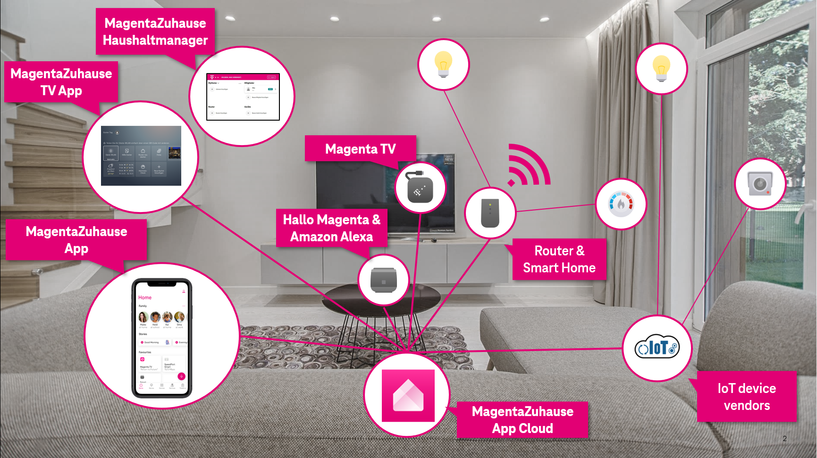
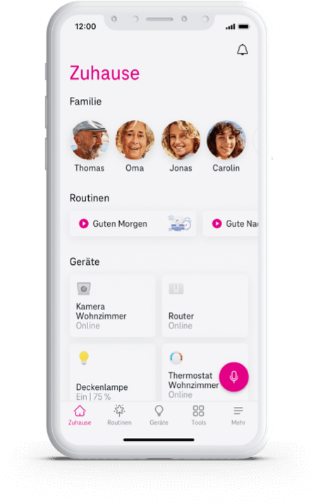

Slide 3







LXC Container based on Eclipse Smart Home
MagentaZuhause Mobile & Web & TV Apps
Zigbee
WoT-inspired protocol
Homematic
GraphQL API
DECT
MQTT/Kafka
HTTP/WebSocket
MagentaZuhauseApp Cloud Rule Engine +
Digital Twin + Cloud Connectors
Proprietary protocols
IP
Notes:
GraphQL API is not public

Slide 4
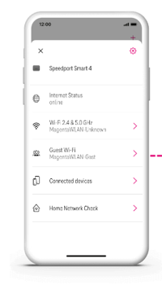

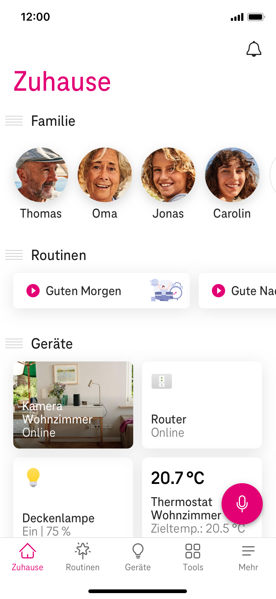
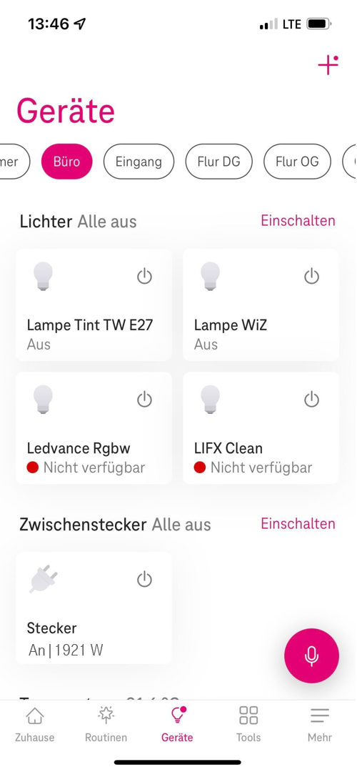

MagentaZuhause App
We help you create a connected home that takes care of the people and things inside.
Good & safe family life Take care of your loved ones and manage everyday family coordination with ease.
Smarter home Gain security and comfort for your home.
Notes:
Routinen erwähnen Alarm Systems
Housesitter
Heating system Presence Detection

Slide 5
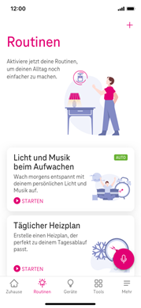
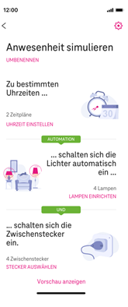
MagentaZuhause App – Routine templates
Trigger
Time-based (cron)
Sunrise / Sunset
Thing Property Changes
Thing Events
Conditions (and/or)
Thing Property Conditions
Date Time Conditions
Actions
Change Thing properties
Invoke Thing Actions
Enable/Disable rules
Lock/unlock Things
Save/restore Thing properties
Notes:
Alarm Systems
Housesitter
Heating system Presence Detection

Slide 6
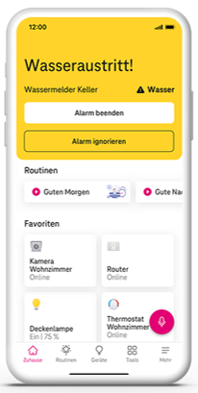
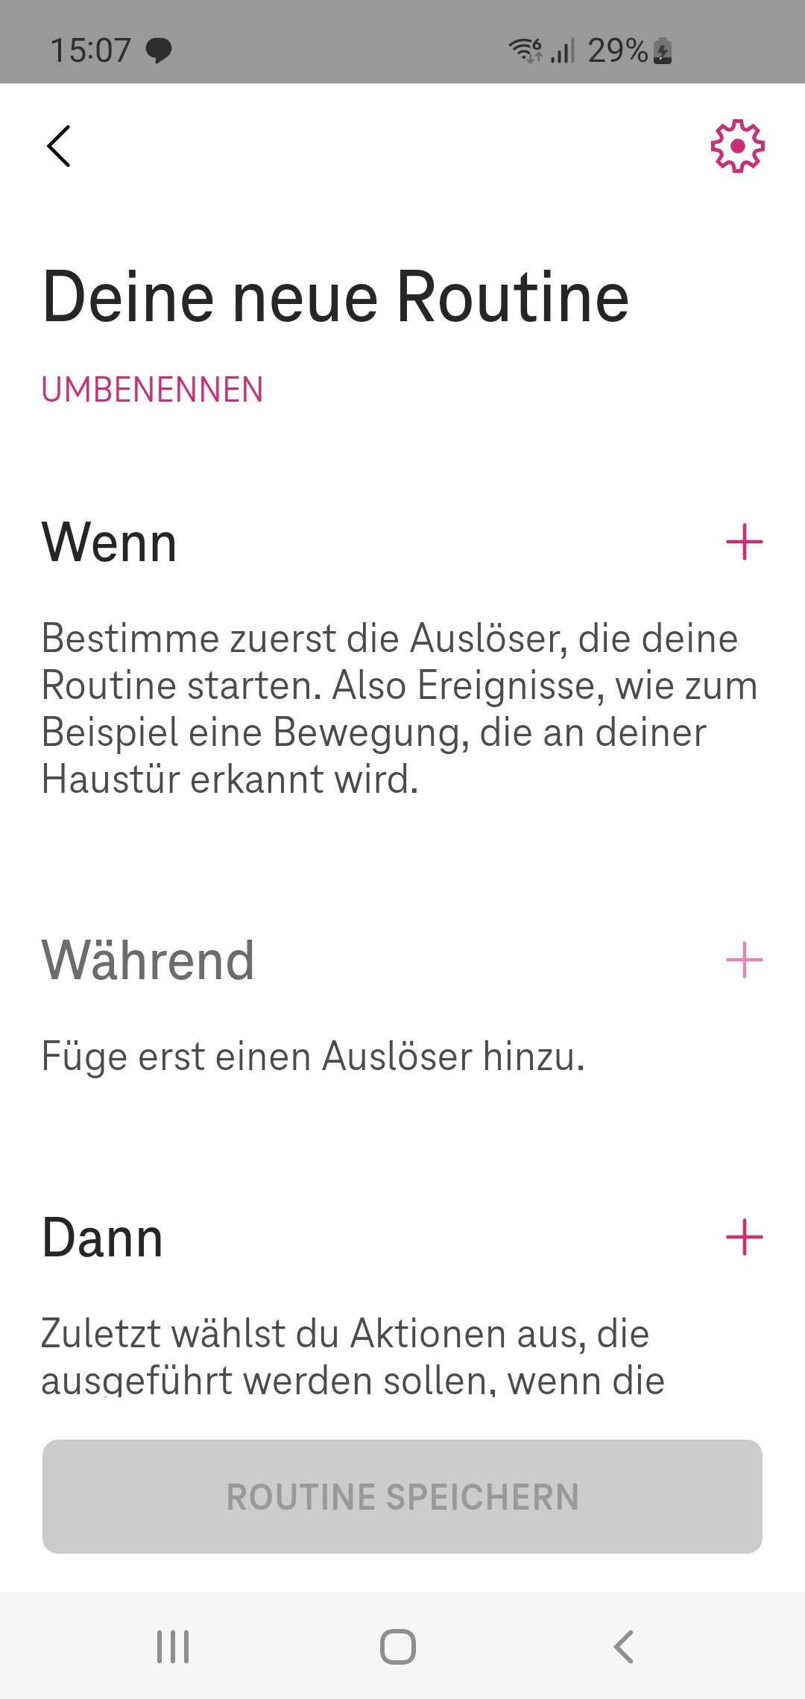
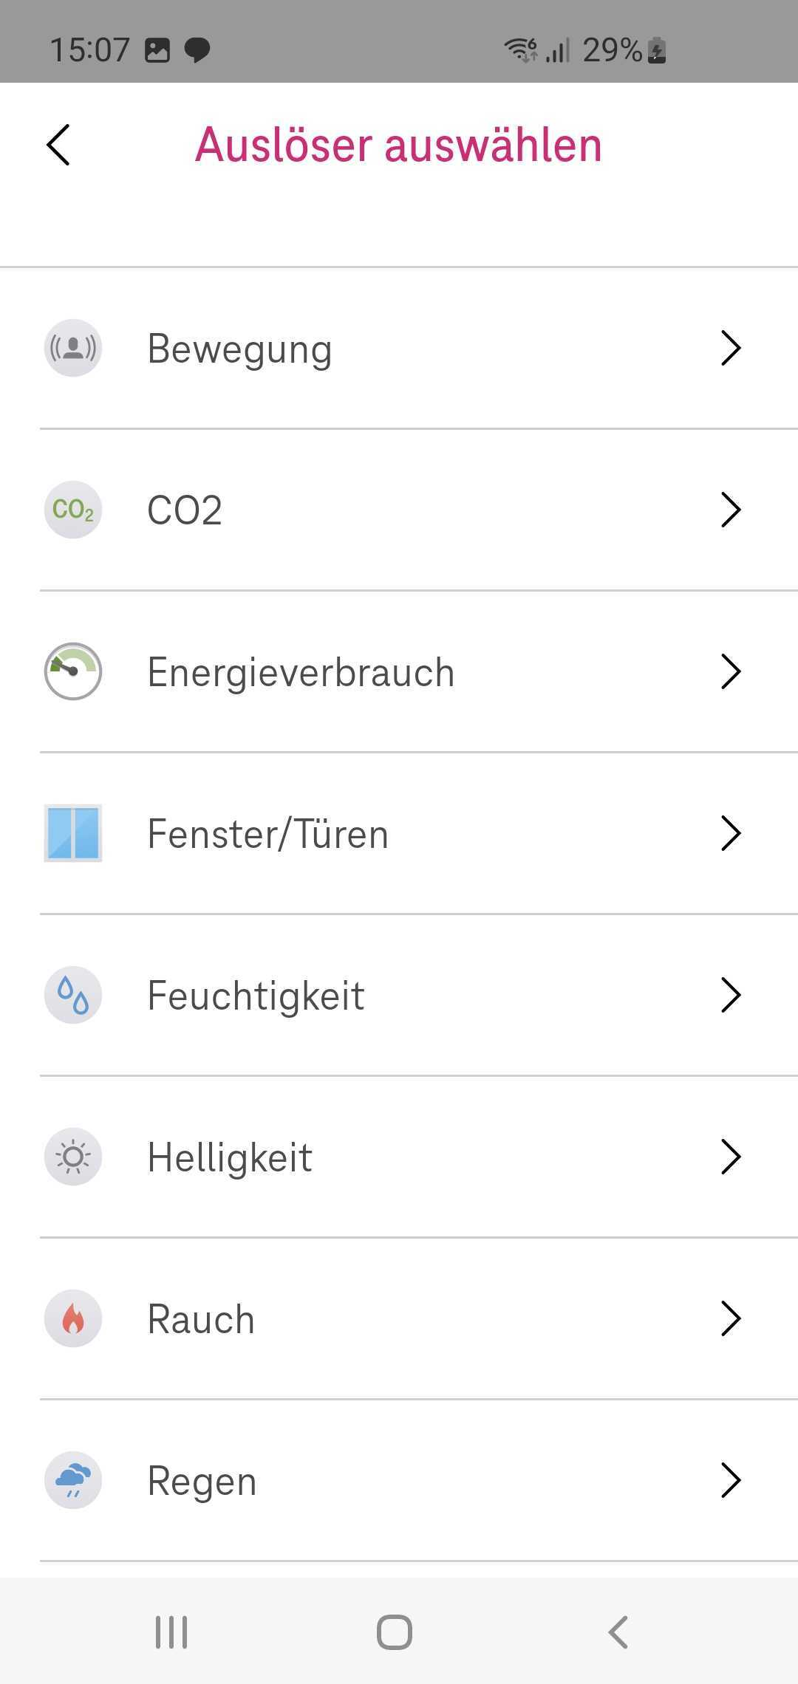
MagentaZuhause App – Custom routines
Notes:
Routinen erwähnen Alarm Systems
Housesitter
Heating system Presence Detection

Slide 7

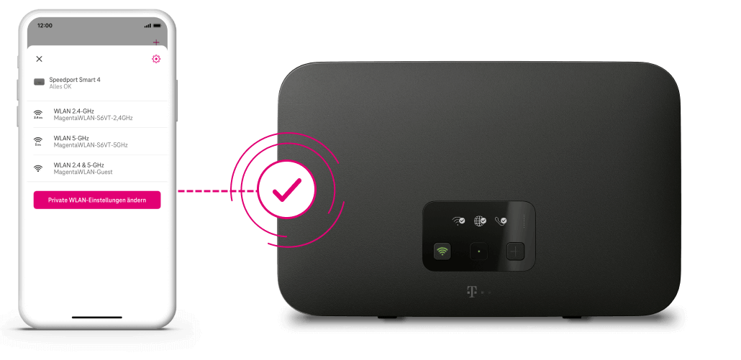
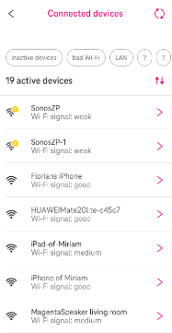
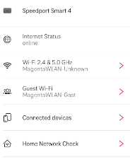
MagentaZuhause App
Worry-free WiFi Easy home network management for everyone in your household.
Notes:
- Wifi configuration
- Connected devices
- Home Network Connect
- Guest Wifi Sharing with QR Code

Slide 8
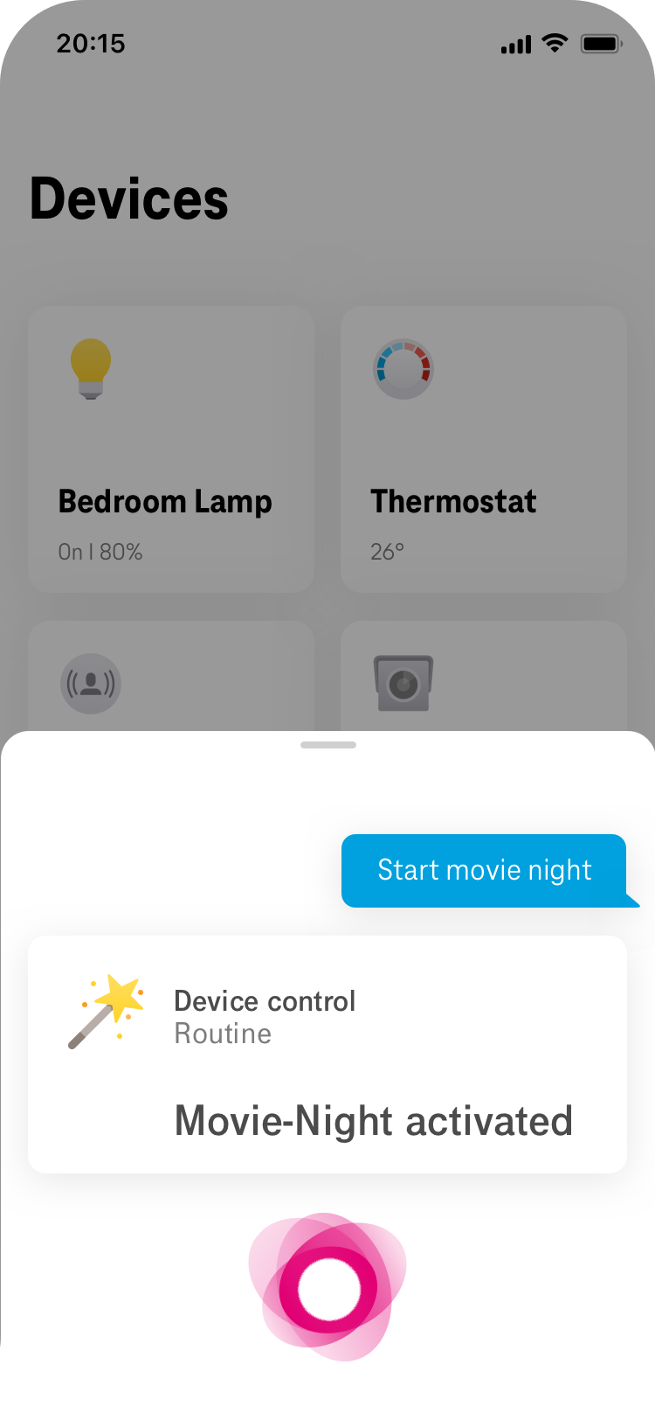




MagentaZuhause App
Integrated seamlessly Magenta Voice Assistant applies to the whole MagentaZuhause Eco System.
Start movie night
Natural interaction Magenta Voice Assistant remedies the need for complex user interfaces and complex navigation.

Slide 9
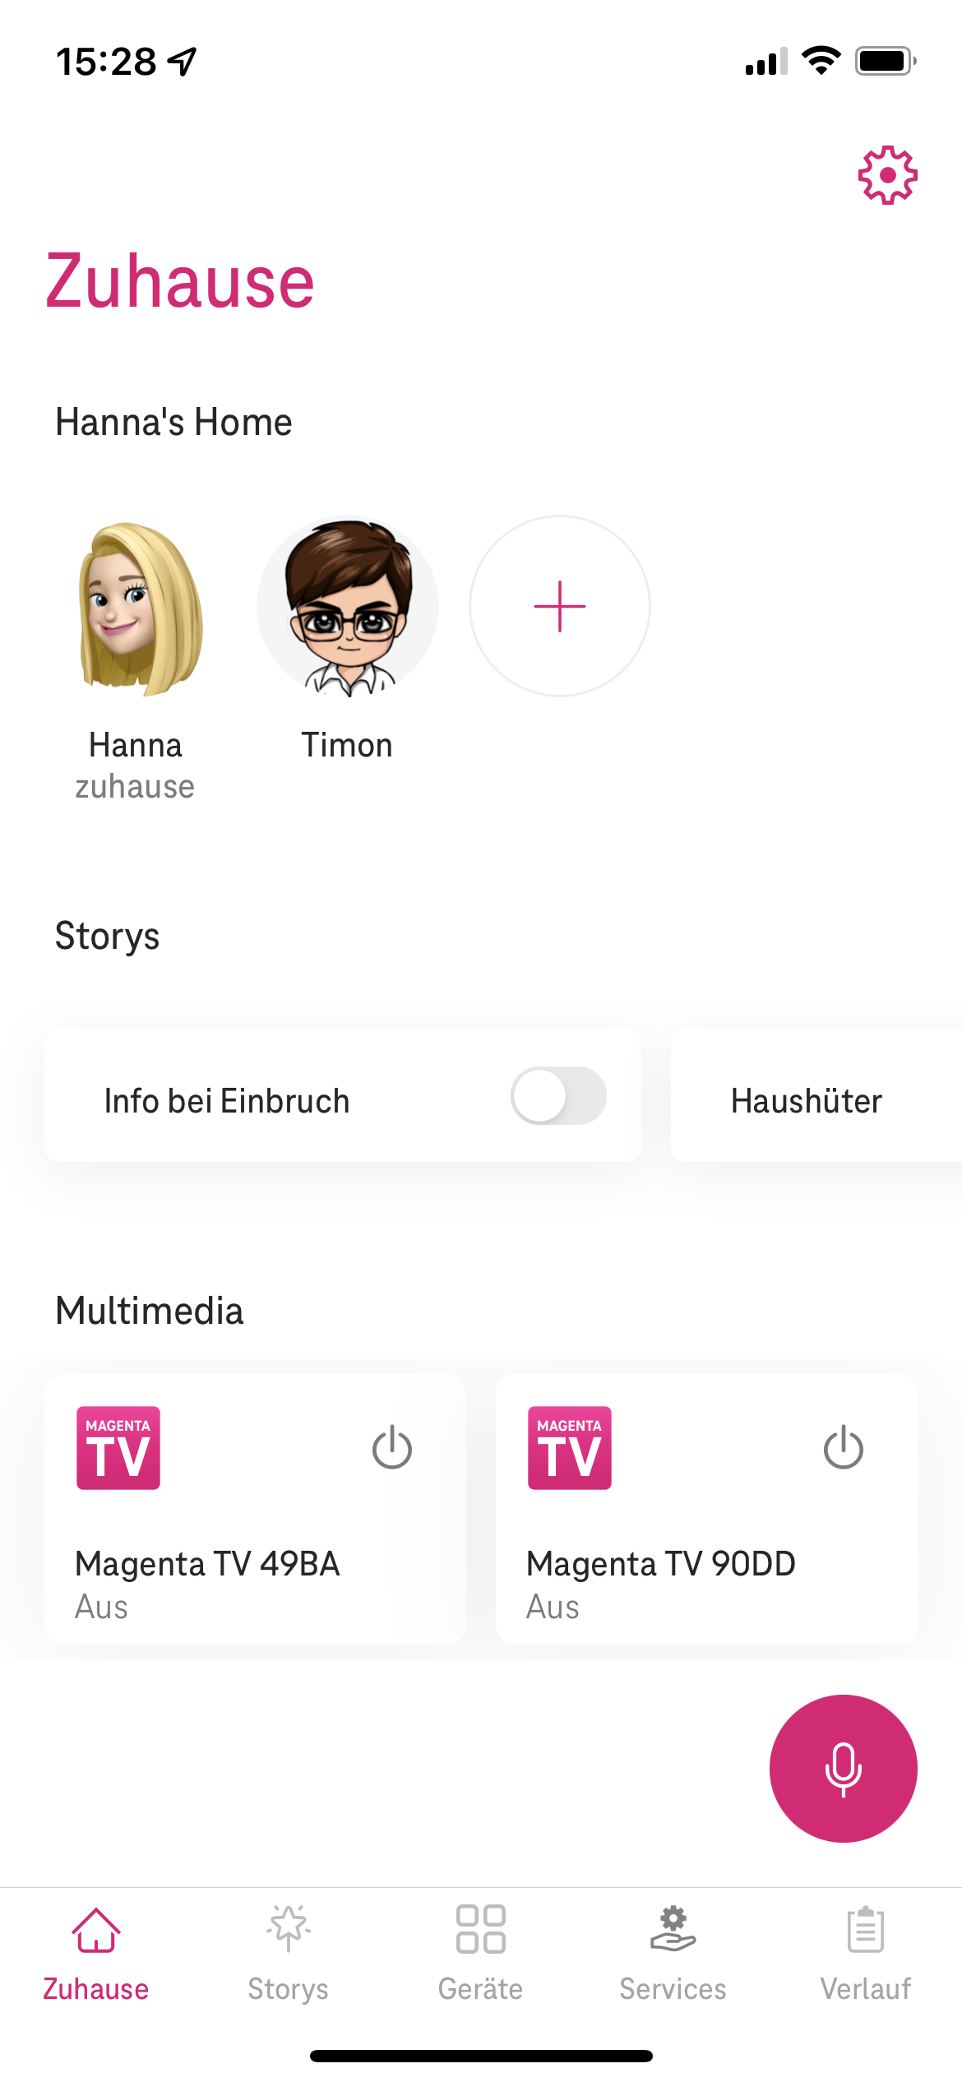
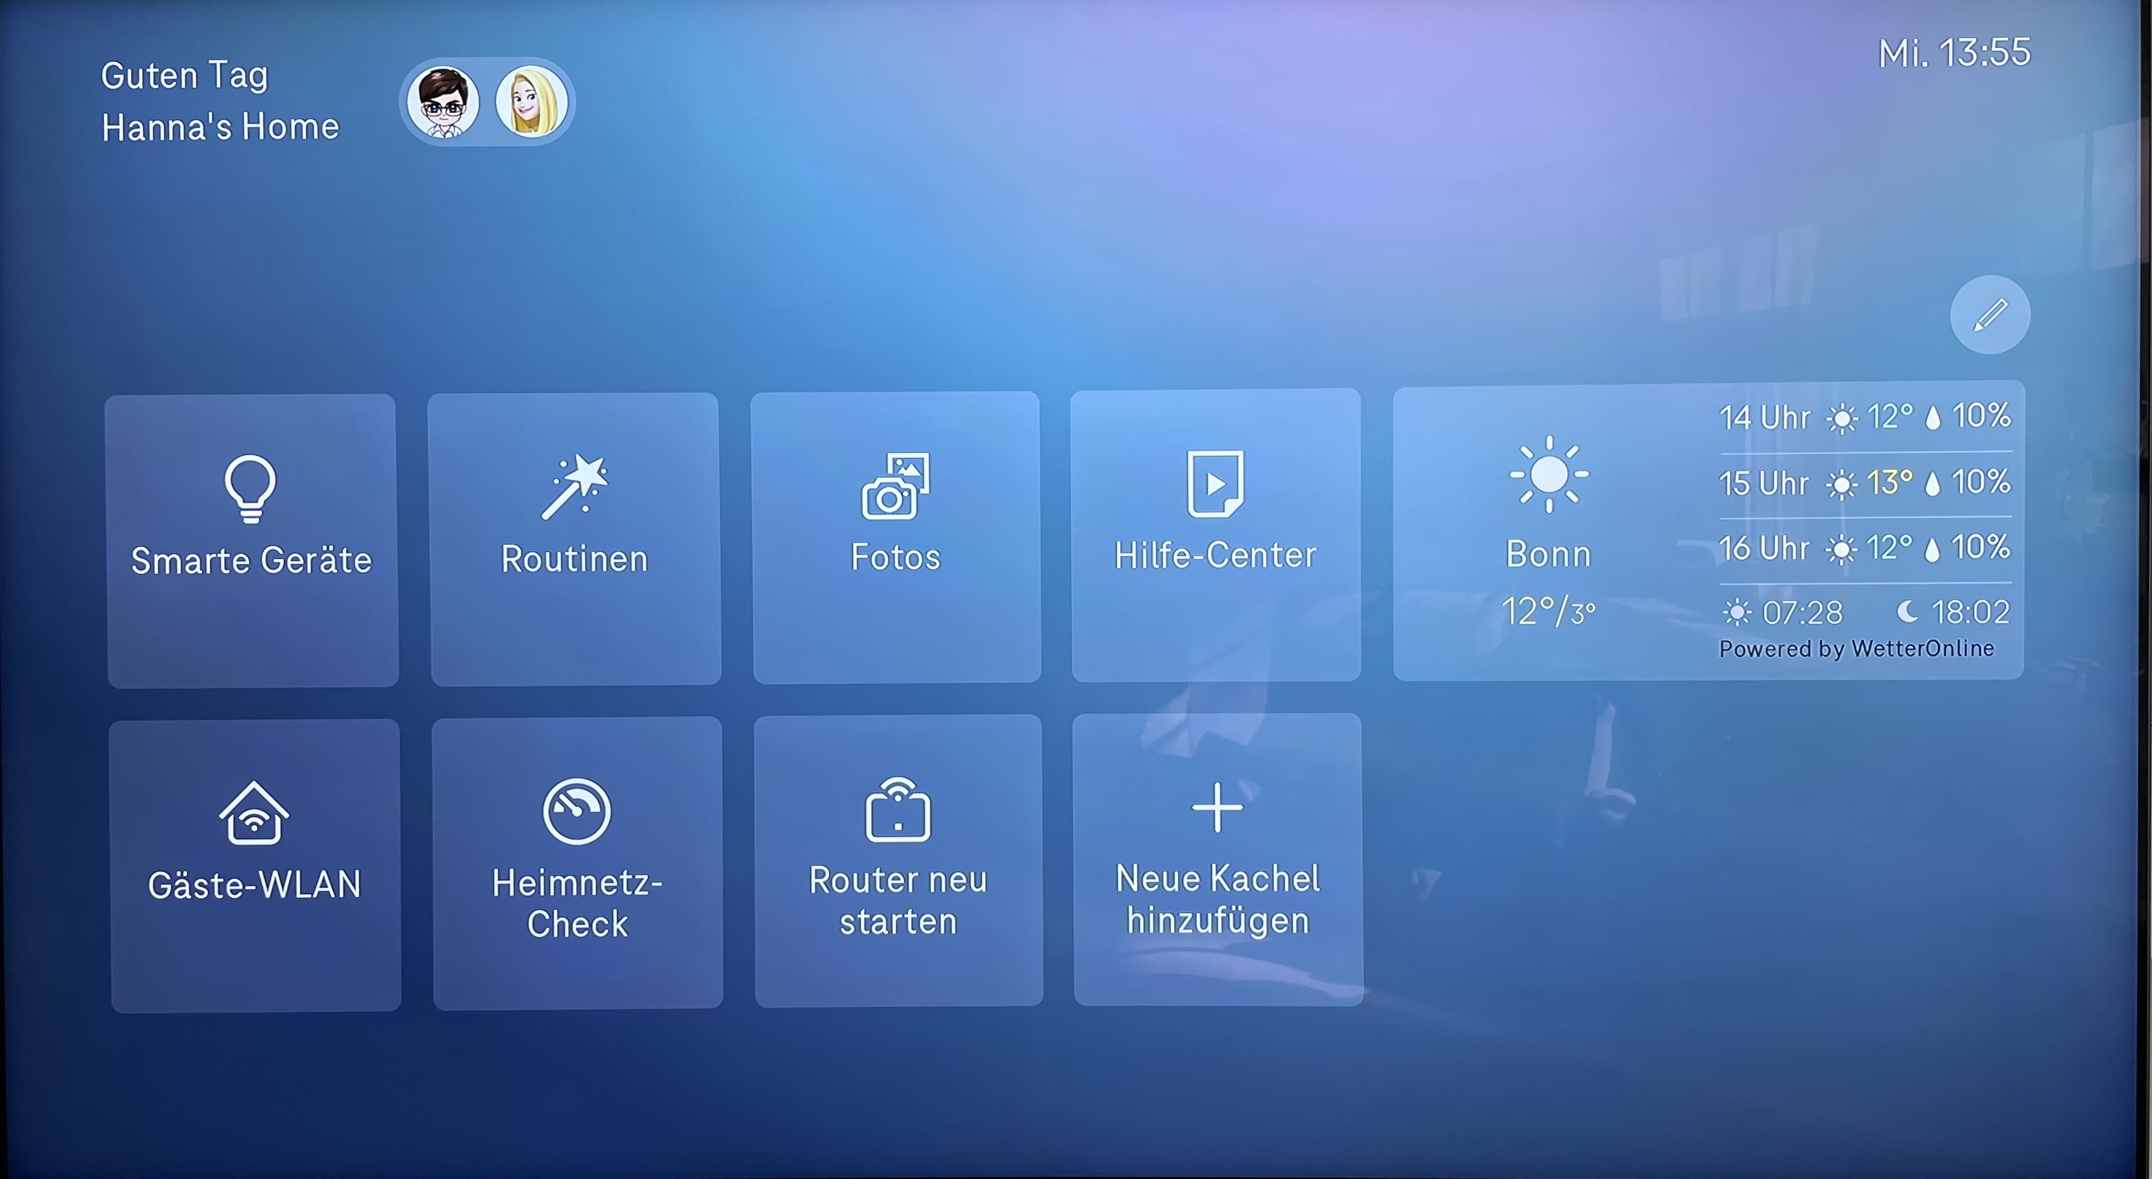
MagentaZuhause TV & Mobile App
9
Notes:
- QR Code Sharing
- Alarm Widgets on TV

Slide 10
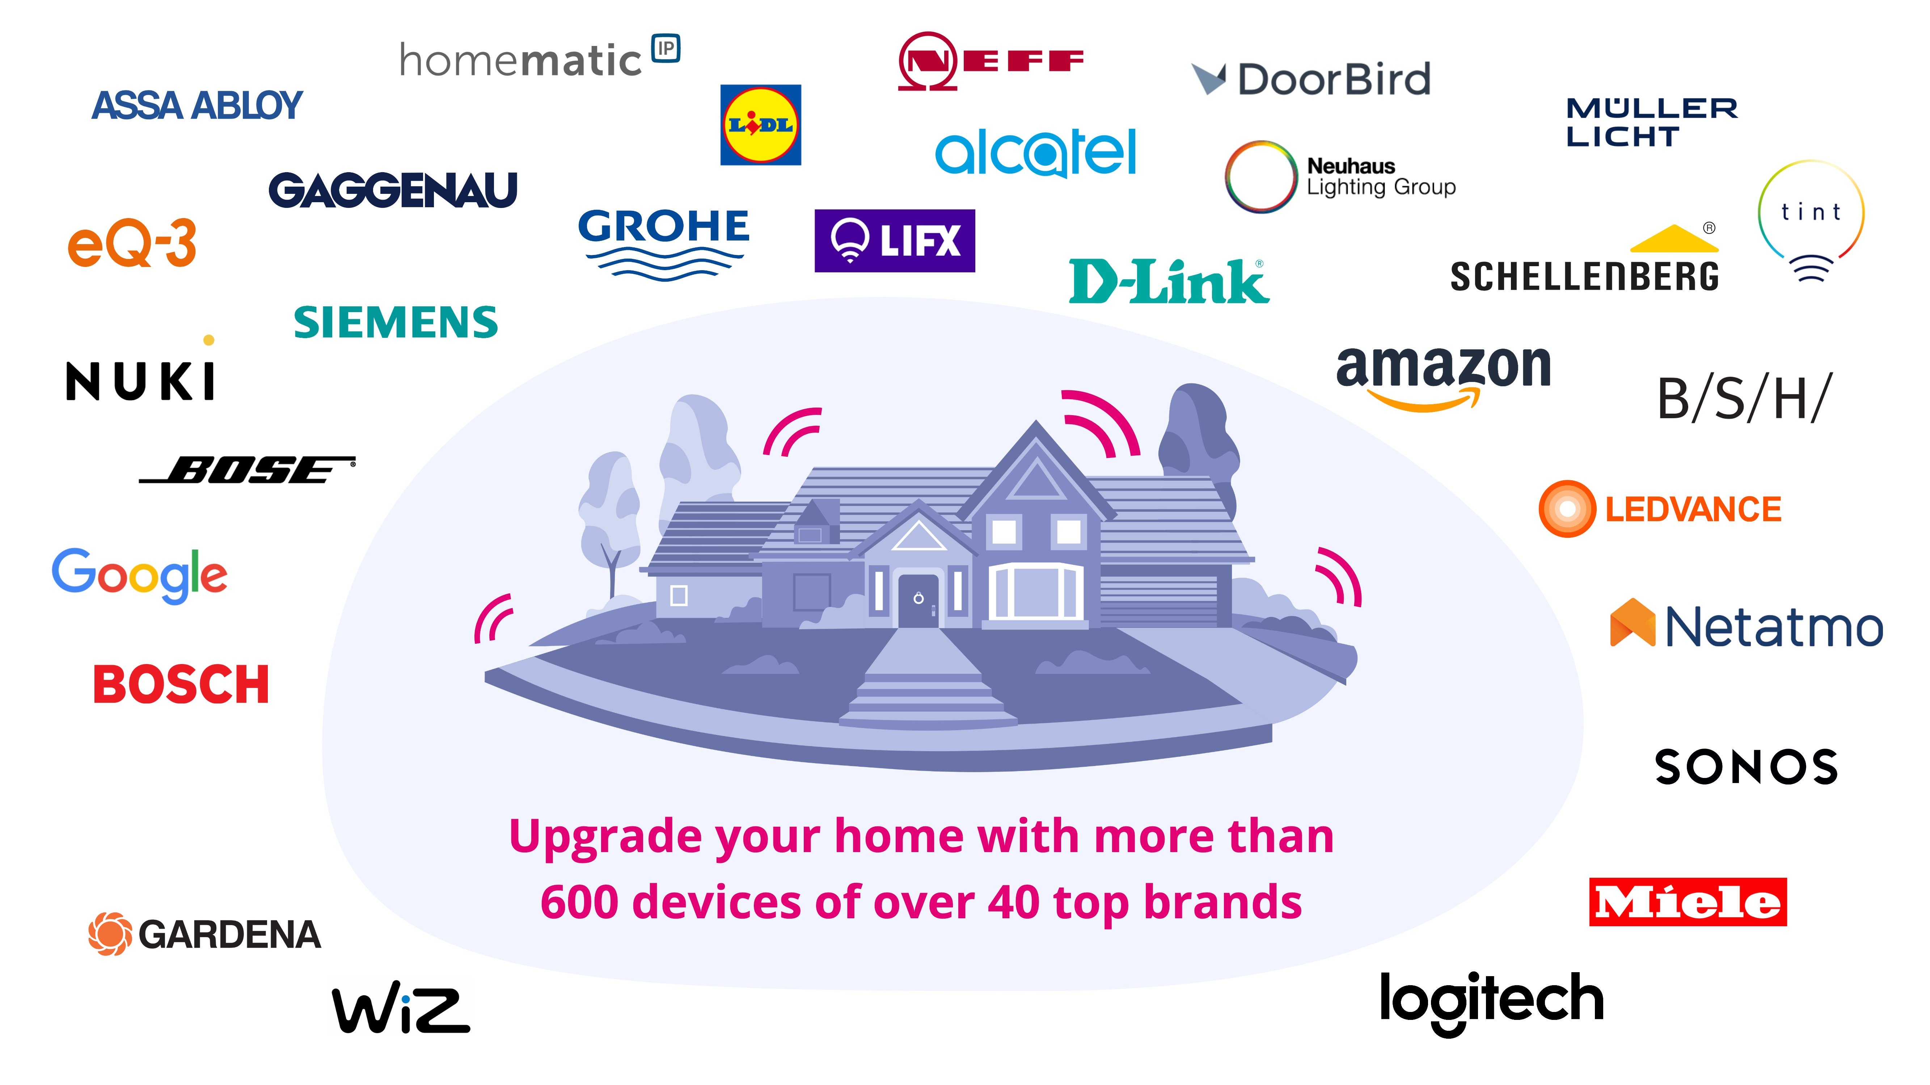

IKEA
Notes:
Gateway-less features erwähnen

Slide 11
WoT Data Model
A W3C Web of Things (WoT) Thing Description insipired data model is used to describe Things in a machine-readable format.
A Thing is an abstraction of a physical device, virtual device or web service
A Thing has a state (in form of properties)
A Thing has functions (actions) which can be executed to change the state
A Thing can emit events, e.g., MotionDetected, BatteryLow, ButtonPressed
A Thing has meta data, e.g., vendor, brand, model, serial number.
Thing purposes: A Thing can have multiple purposes: Lighting, MotionDetection, AmbientLightSensing
Thing category: A Thing belongs to one category, e.g. LightBulb, ColorLightBulb, ContactSensor, Camera, Plug …

Slide 12
WoT Data Model
A W3C Web of Things (WoT) Thing Description insipired data model is used to describe Things in a machine readable format.
A Thing is an abstraction of a physical device, virtual device or web service
A Thing has a state (in form of properties)
A Thing has functions (actions) which can be executed to change the state
A Thing can emit events, e.g., MotionDetected, BatteryLow, ButtonPressed
A Thing has meta data, e.g., vendor, brand, model, serial number.
Thing purposes: A Thing can have multiple purposes: Lighting, MotionDetection, AmbientLightSensing
Thing category: A Thing belongs to one category, e.g. LightBulb, ColorLightBulb, ContactSensor, Camera, Plug …

Slide 13
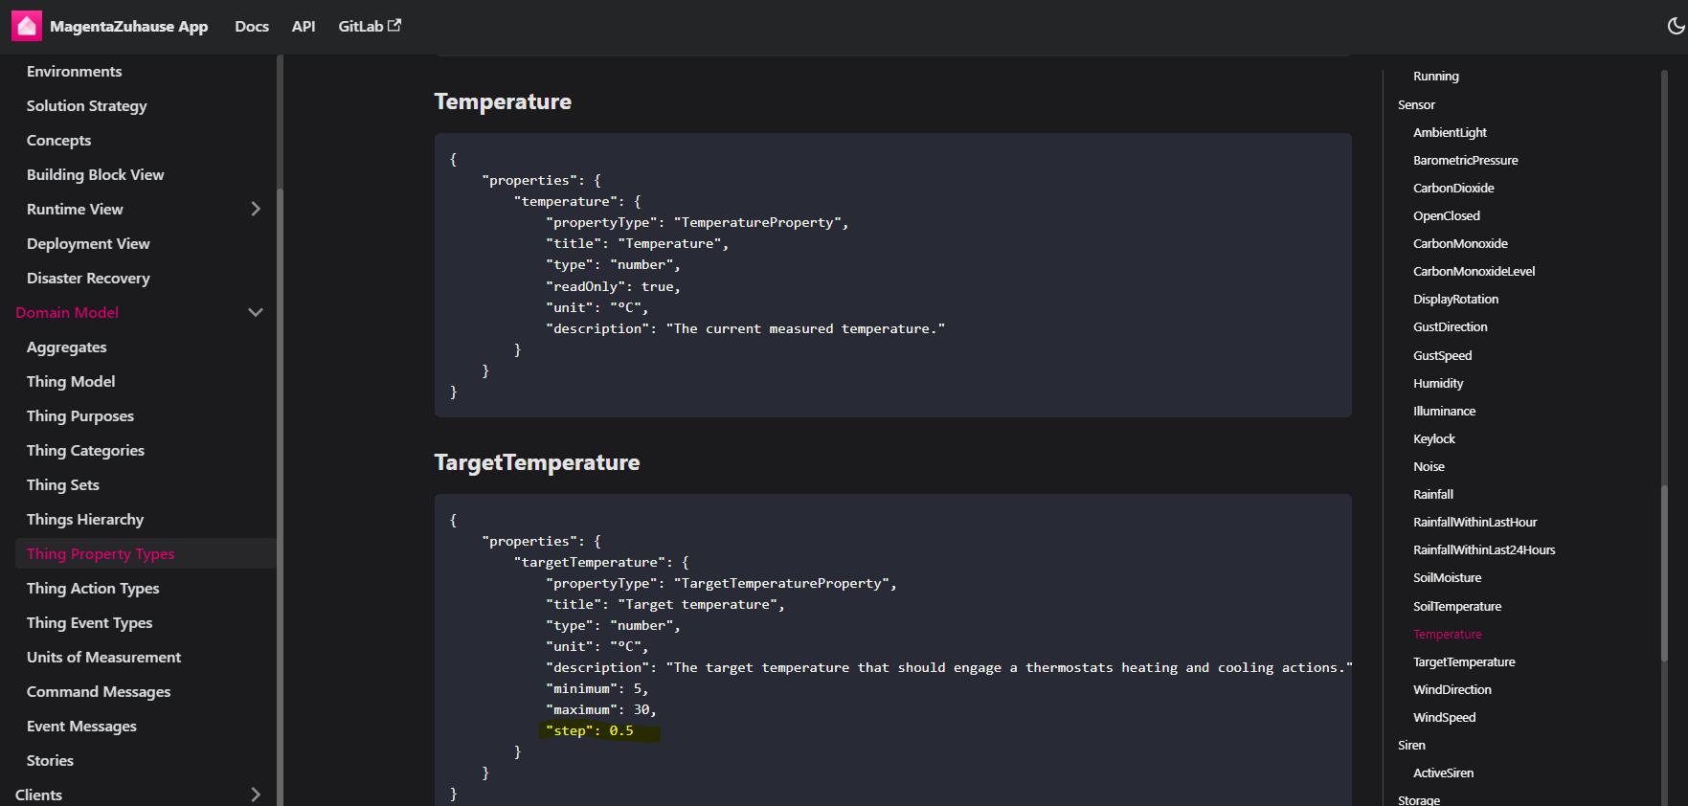
WoT Data Model

Slide 14
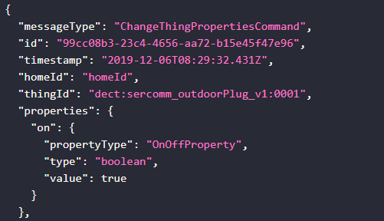
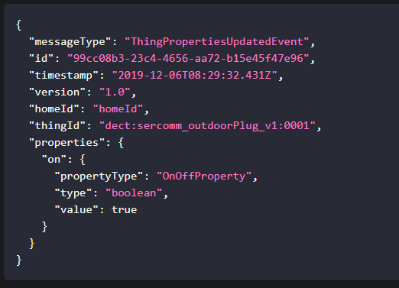
WoT Data Model
Change Thing Properties Commands
Thing Properties Updated Events

Slide 15
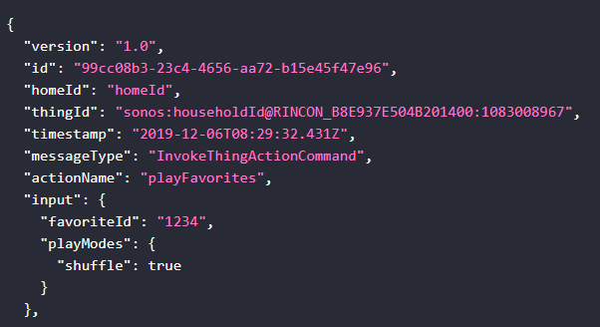
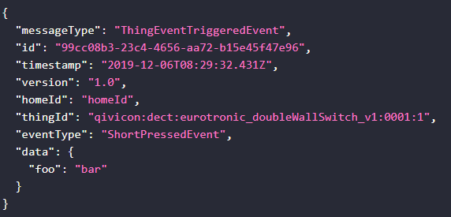
WoT Data Model
Invoke Thing Actions Commands
Thing Events

Slide 16
Challenges
Use a higher abstraction „purpose“ instead of device category for icons
Bulb or Lightstrip vs Lighting
AlarmSystem vs PresenceMonitoring or LifeProtection or DamagePrevention
Group of Things
Rooms, Floors, Virtual Groups have user chosen names
Room, Floor, Group as Thing or different concept?
N:M relationship
Personal ownership of Things
Devices can belong to persons
Things are managed by some 3rd party connection

Slide 17
Challenges
Parent/child relationships between Things:
AlarmSystem and Sensors
SoundSystem, Loudspeaker Group and LoudSpeaker
Remote Control and different types of Buttons
Camera and optional SSD card
Update mechanism of Things
Last update and last changed timestamp for properties

Slide 18
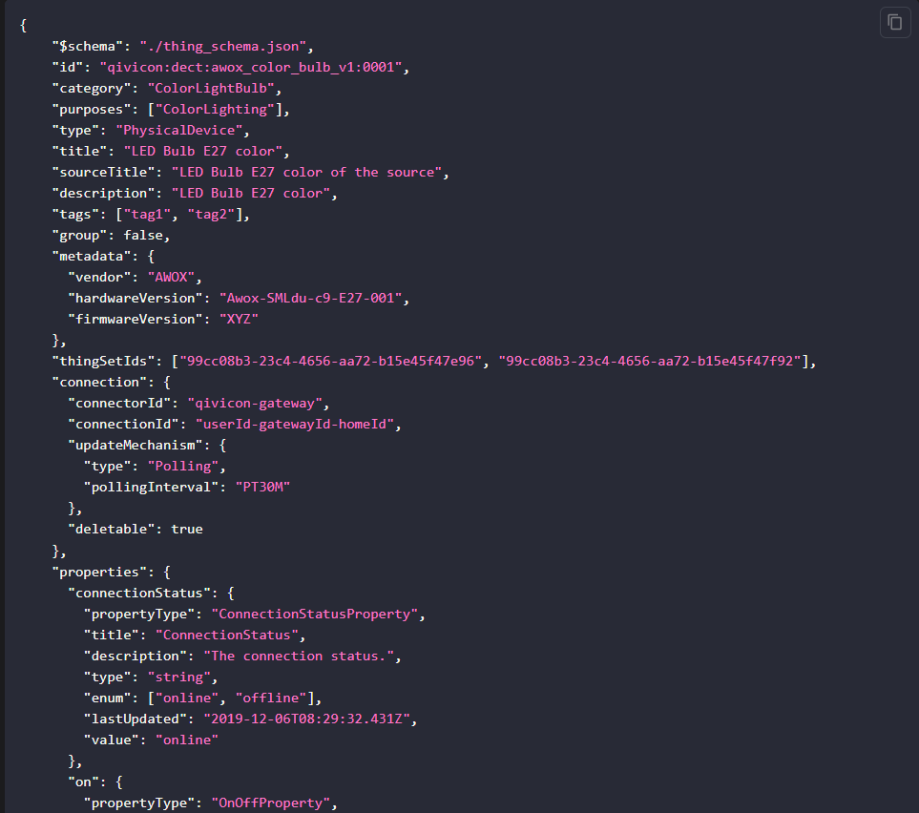

Slide 19
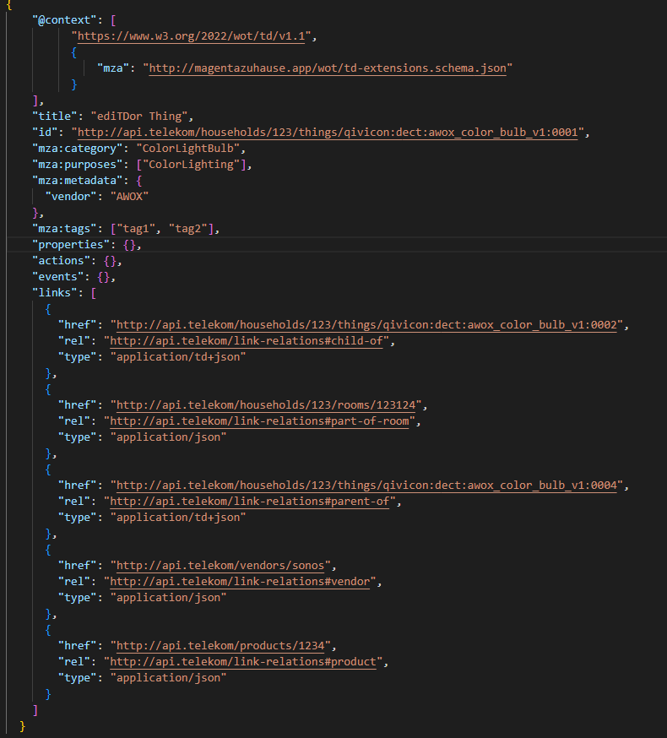

Slide 20
Challenges
Binding Template and Protocol Vocabulary for GraphQL
"safe": false on properties
By which action is a property modified
Which properties does an action modify
Update mechanism (none, polling, real-time) and interval on property-basis
Context of a property: indoor vs outdoor
User can use the device differently
Dynamically adjust the actions which are possible based on the state of the device
Can a property be locked/unlocked?

